Slide 1
Design and Analysis of Algorithm
UNIT-III
Dynamic Programming
M Yogi Reddy
Assistant Professor,
Dept. of CSE,
School Of Technology,
GITAM(Deemed to be ) University,
Hyderabad.

Slide 2

Dynamic Programming Applications
Multistage graphs
All pairs shortest paths
Optimal binary search trees
Reliability design
Travelling sales person problem

Slide 3
Principle of optimality:
Suppose that in solving a problem, we have to make a sequence of decisions D1, D2, …, Dn. If this sequence is optimal, then the last k decisions, 1 < k < n must be optimal.
e.g. the shortest path problem
If i, i1, i2, …, j is a shortest path from i to j,
then i1, i2, …, j must be a shortest path from i1 to j

Slide 4
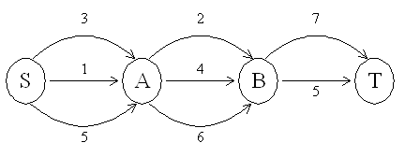
The Shortest Path
To find a shortest path in a multi-stage graph
Apply the greedy method:
the shortest path from S to T:= 8.

Slide 5
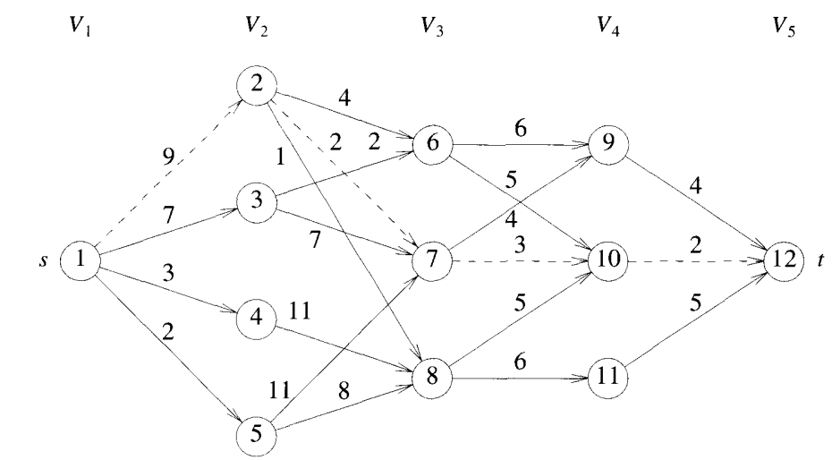
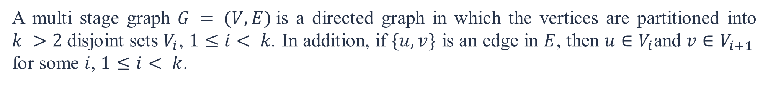
The shortest path in multistage graphs
A multi stage graph $G = (V, E)$is a directed graph in which the vertices are partitioned into $k >2$disjoint sets $V_{i}$, $1≤i< k$. In addition, if $\{u,v\}$ is an edge in $E$, then $u∈V_{i}$and $v∈V_{i+1 }$ for some $i$, $1≤i< k$.

Slide 6
The Multi-Stage Graph Solution
Dynamic Programming Forward approach and Backward approach:
If the recurrence relations are formulated using the forward approach, the relations are solved backward, i.e., beginning with the last decision.
If the recurrence relations are formulated using the backward approach, the relations are solved forwards.
To solve a problem by using dynamic programming:
Find out the recurrence relations.
Represent the problem by a multi-stage graph.

Slide 7
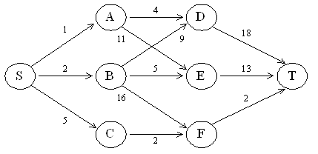
The Shortest Path in Multi-stage Graphs
For example
The greedy method cannot be applied to this case:
(S, A, D, T) = 23.
The real shortest path is:
(S, C, F, T) = 9.

Slide 8
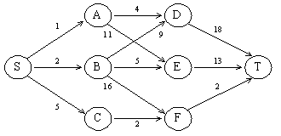
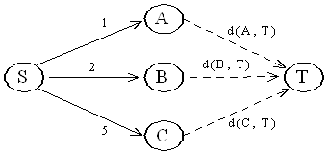
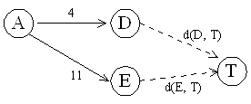

The shortest path in multistage graphs (forward approach and relations are backward)
d(S, T) = min{1+ d(A, T), 2+d(B, T), 5+d(C, T)}
d(D,T)= 18
d(E,T)= 13
d(A, T) = min{4 + d(D, T), 11+ d(E, T)}
$$d\left(A,T\right)=\min\left(4+18\right), 11+13)=22$$

Slide 9
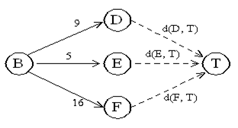
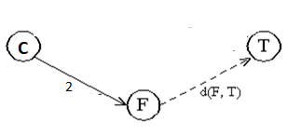

d(D,T)= 18
d(E,T)= 13
d(F,T)= 2
d(B, T) = min{(9+d(D, T), 5+d(E, T), 16+d(F,T) }
$$d\left(B,T\right)=\min\left(9+18\right), 5+13,16+2)=18$$
d(C, T) = 2+ d(F,T)
$$d\left(C,T\right)=2+2=4$$
d(F,T)= 2
d(S, T) = min{1+d(A, T), 2+d(B, T), 5+d(C, T)}
d(S, T) = min{1+22, 2+18, 5+4}
= min{23, 20, 9}
= 9

Slide 10
The shortest path in multistage graphs (backward approach and relations are forward)
d(S, A) = 1
d(S, B) = 2
d(S, C) = 5
d(S,D) =min{d(S, A)+d(A, D), d(S, B)+d(B, D)}
= min{ 1+4, 2+9 }
= 5
d(S,E)= min{d(S, A)+d(A, E), d(S, B)+d(B, E)}
= min{ 1+11, 2+5 }
= 7
d(S,F)= min{d(S, A)+d(A, F),d(S, B)+d(B, F)}
= min{ 2+16, 5+2 }
= 7

Slide 11
d(S,T) = min{d(S, D)+d(D, T), d(S,E)+ d(E,T), d(S, F)+d(F, T)}
= min{ 5+18, 7+13, 7+2 }
= 9

Slide 12
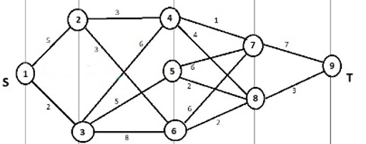
Question 1
What is the shortest path from source $s$to destination $t.$

Slide 13
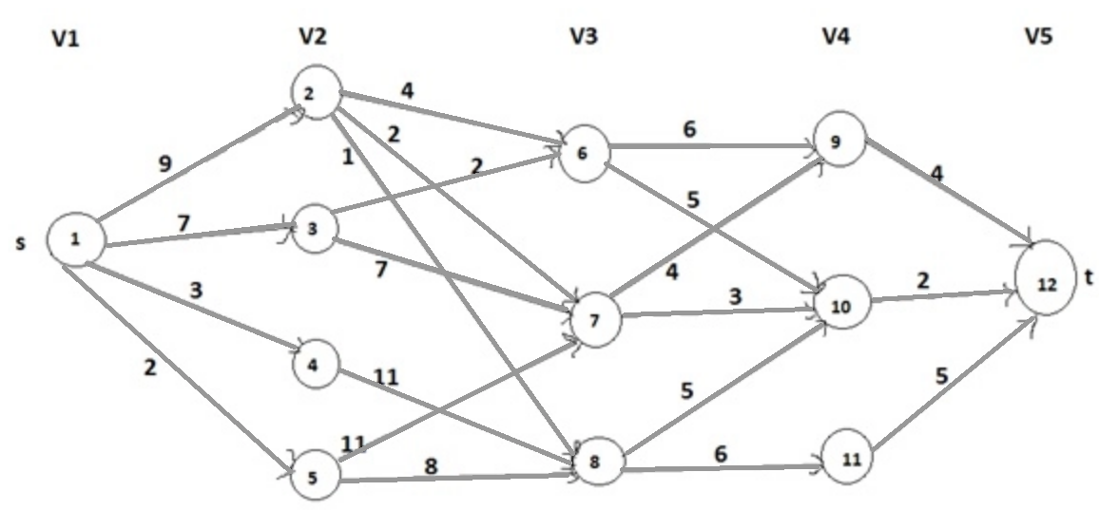
Question 2
What is the shortest path from source $s$to destination $t.$
Sol: 1-> 2-> 7-> 10-> 12

Slide 14
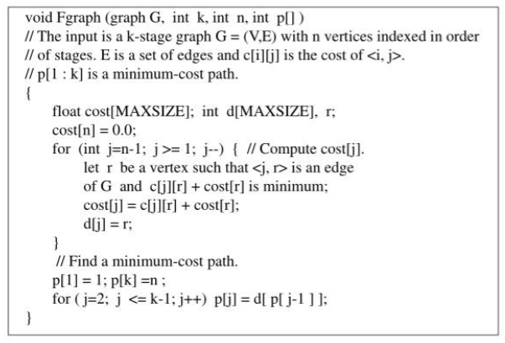
Algorithm

Slide 15
Programming
int Multistage(int graph[N][N])
{
// dist[i] is going to store shortest distance from node i to node N-1.
int dist[N]; dist[N-1] = 0;
// Calculating shortest path for rest of the nodes
for (int i = N-2 ; i >= 0 ; i--)
{
// Initialize distance from i to destination (N-1)
dist[i] = INF;
// Check all nodes of next stages to find shortest distance fromi to N-1.
for (int j = i ; j < N ; j++)
{
// Reject if no edge exists
if (graph[i][j] == INF)
continue;
// We apply equation to distance to target through j.
// and compare with minimum distance so far.
dist[i] = min(dist[i], graph[i][j] + dist[j]);
}
}
return dist[0];
}

Slide 16



